Slide 1
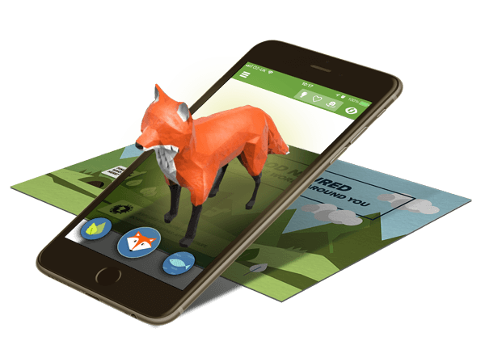
COMPUTER VISION
AUGMENTED REALITY OBJECT INSERTION ON A PLANE
HARSH VARDHAN SINGH (2020202)
SUBHANSHU BANSAL (2020135)
PRAVAR AGGARWAL (2020229)

Slide 2
PROBLEM STATEMENT
OBJECTIVE
Develop a program that can insert 3D objects into a live video feed from a camera, using camera calibration and planar homography techniques.
REQUIREMENTS
The application should be able to detect and track a planar surface in the video feed, and overlay a 3D object onto it, rendering it in real time as the camera moves.
3d object must be stable and smooth and should be simple to use.

Slide 3
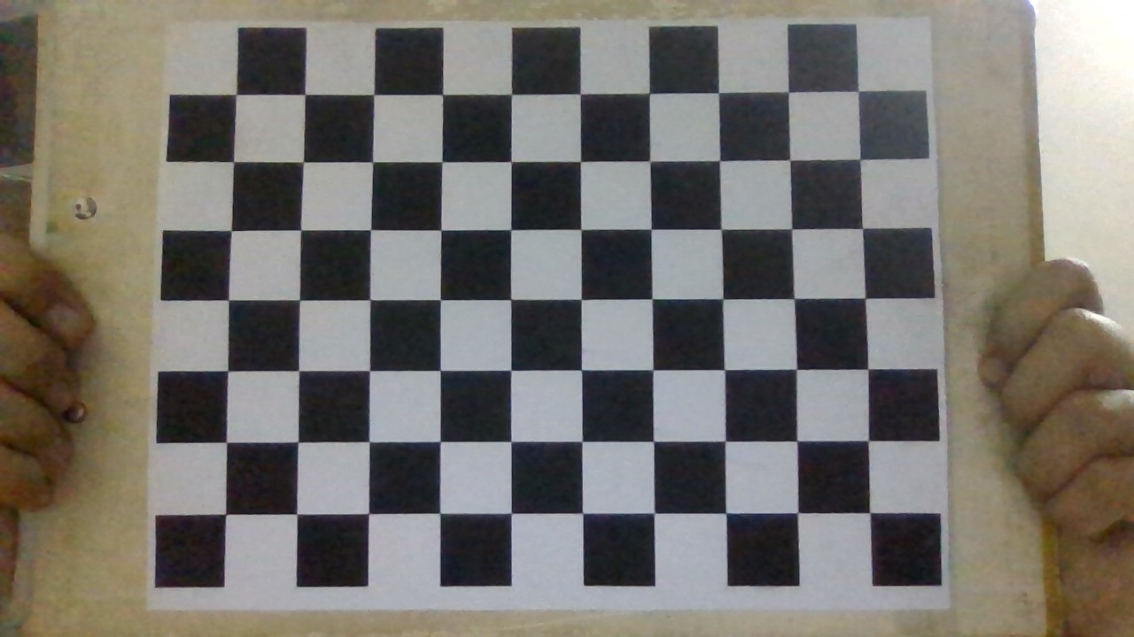
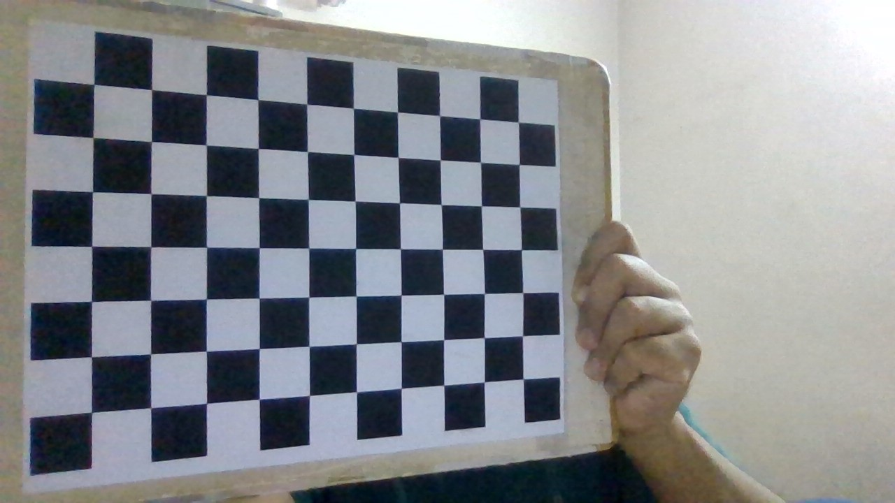
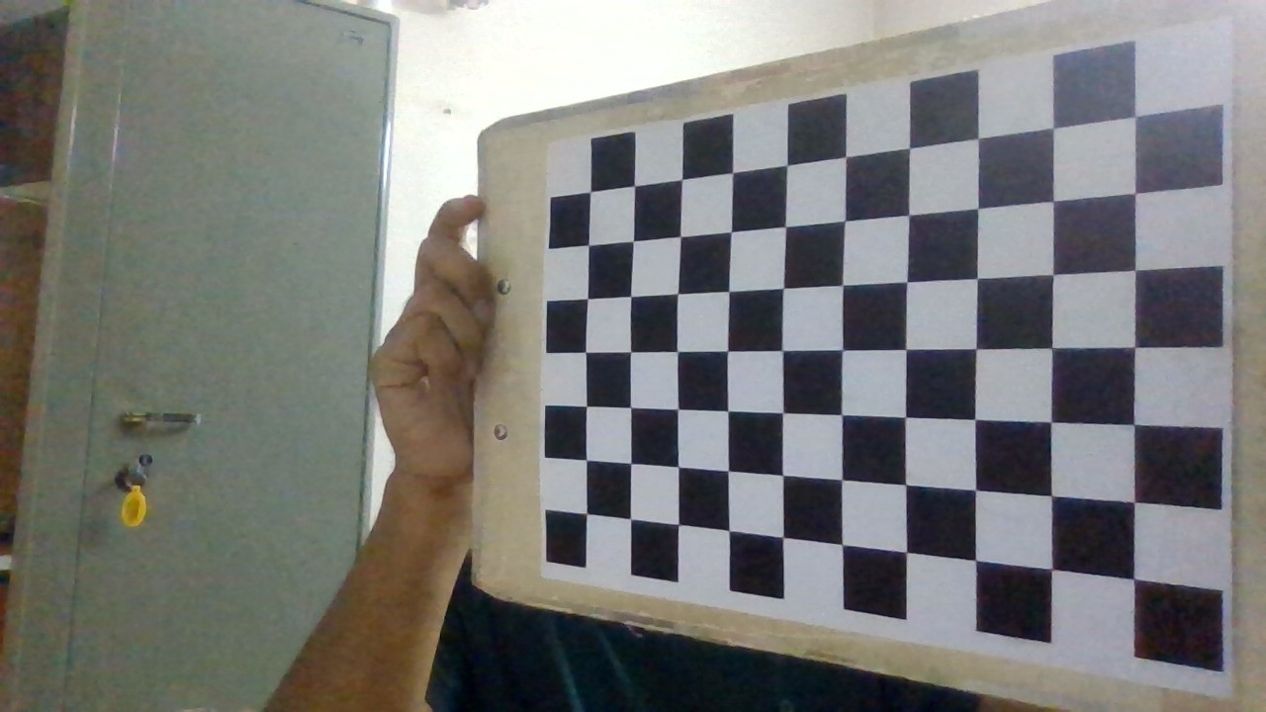
DATA DESCRIPTION
CAMERA CALIBRATION
Using Inbuilt camera of (Lenovo Legion 5)
Using a checkerboard pattern of size (10 x 7) to calibrate camera.
Taking 25 images while holding our checkerboard pattern in different orientations to take into account various degrees of freedom

Slide 4

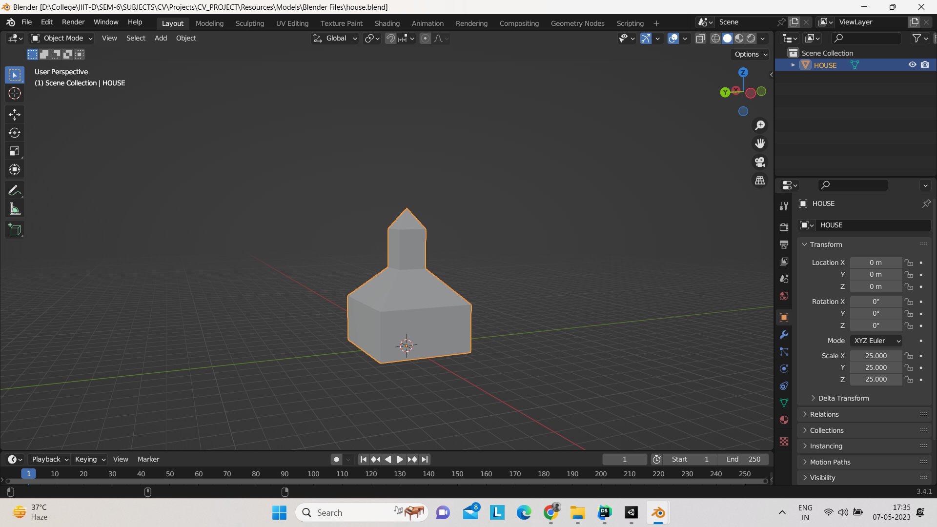
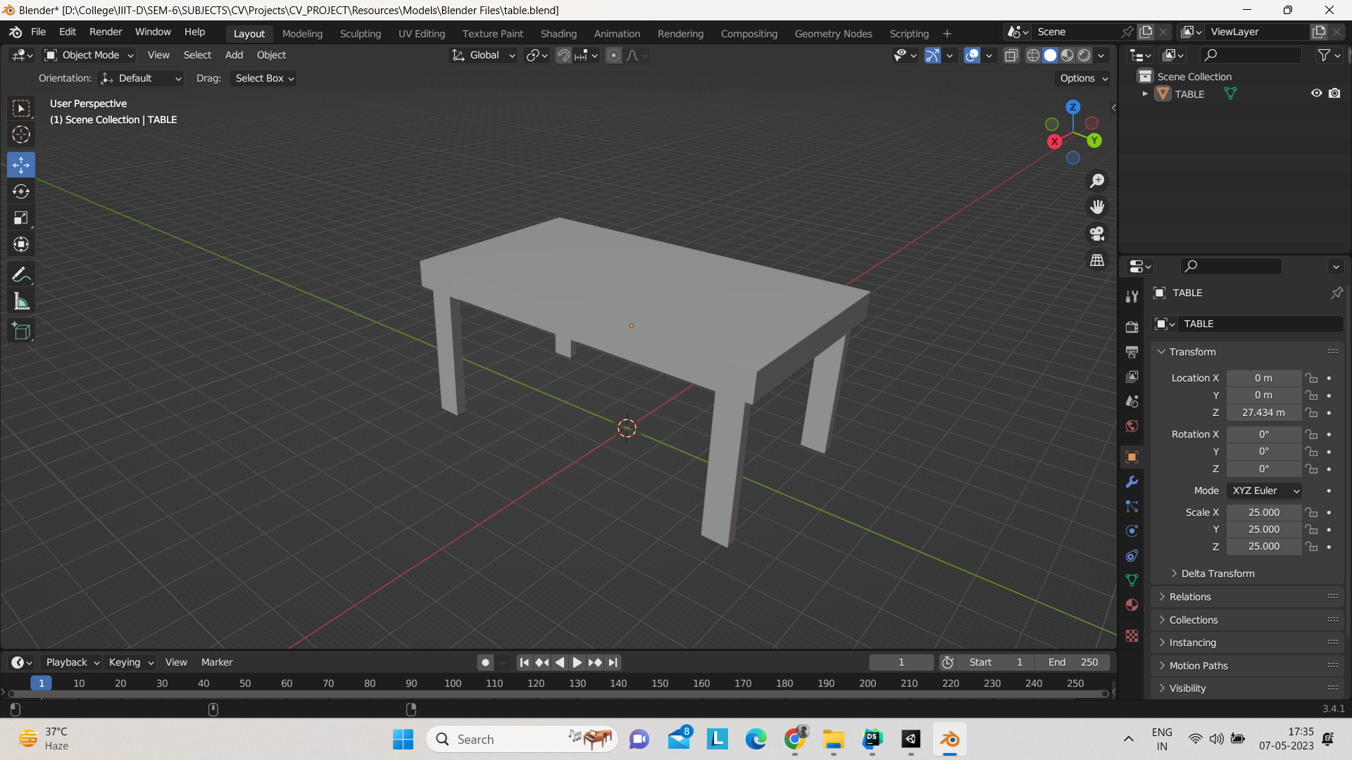
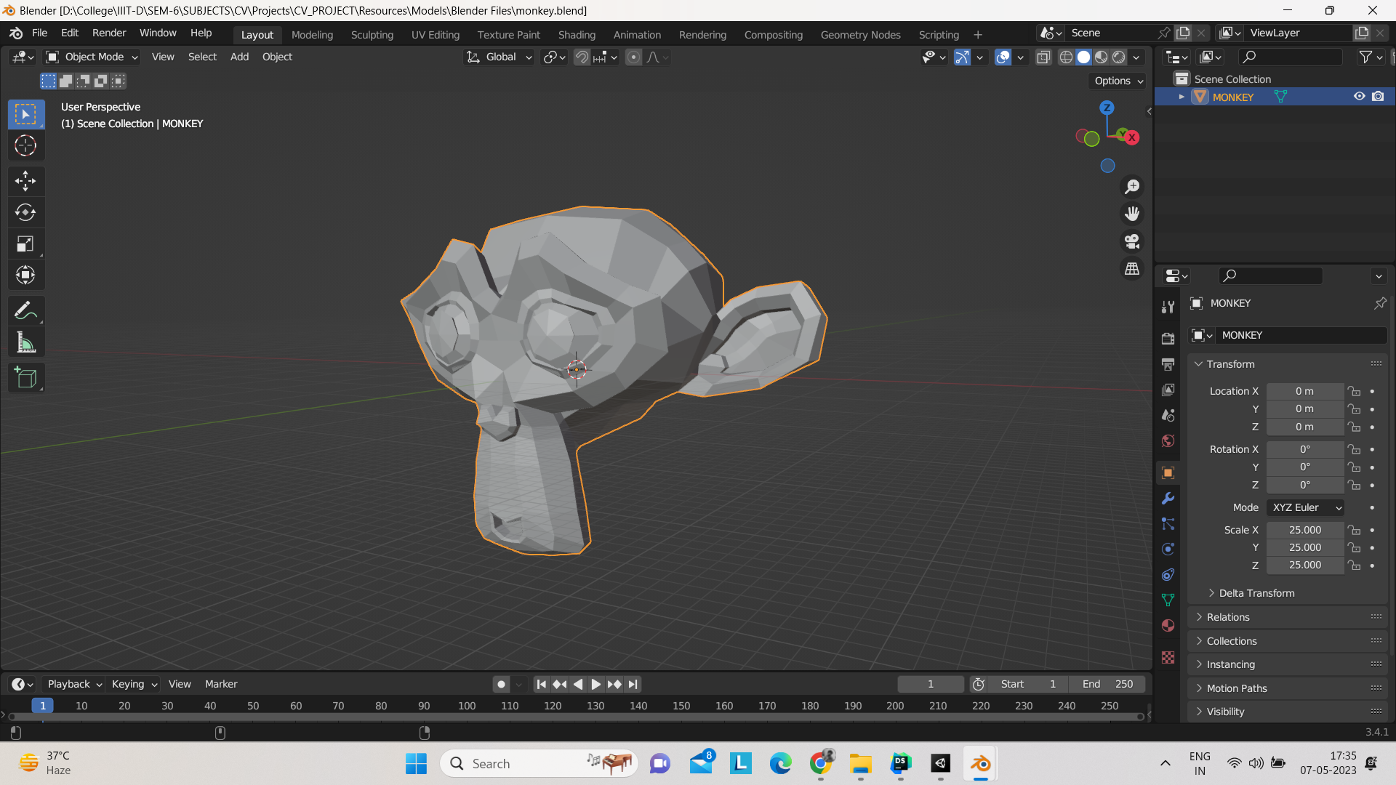
DATA DESCRIPTION
PLANE USED FOR HOMOGRAPHY AND 3D OBJECTS USED
Using a book as our base
Using simple yet easy to comprehend 3d models
BASE BEING USED
3D MODELS BEING USED

Slide 5
METHODOLOGY
THE METHODS USED IN THE PROGRAM ARE AS FOLLOWS …
Camera Calibration using openCV. [Camera_Calibration.py]
Using SIFT and Flann Based algorithm to compute the homographies. [Homographies.py]
Coded modules to extract information from .obj files and rendering them using python and openCV on top of our desired base. [Object_Loader.py]
Our main function to handle the flow of the program and give us the desired output. [Main.ipynb]

Slide 6
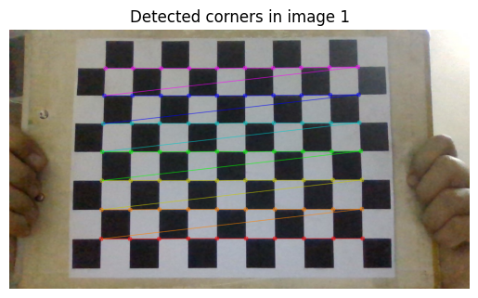
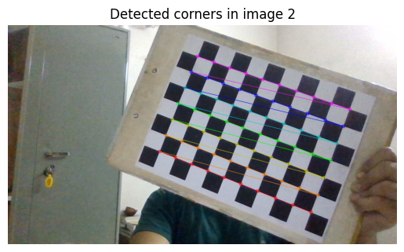
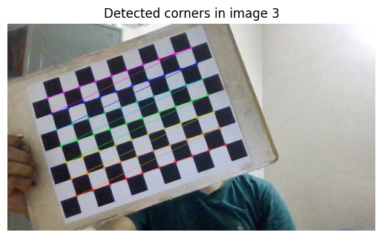
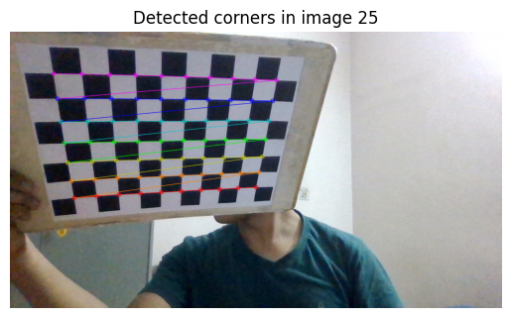
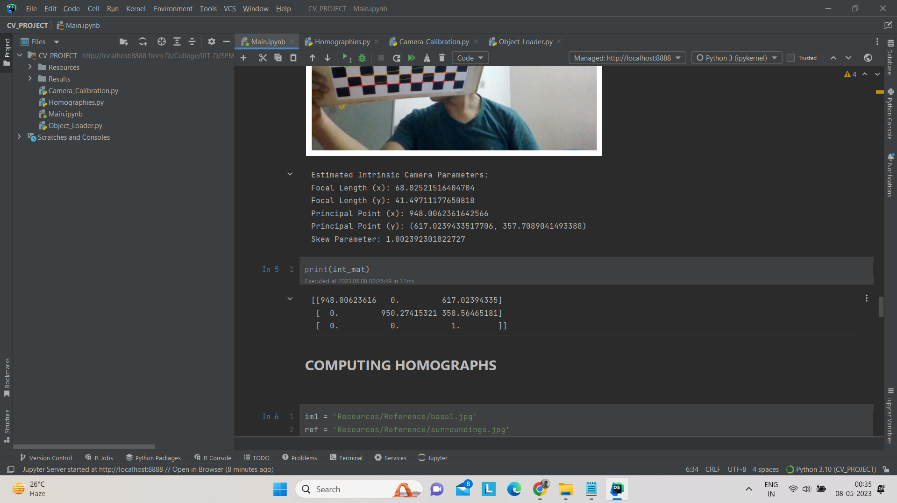
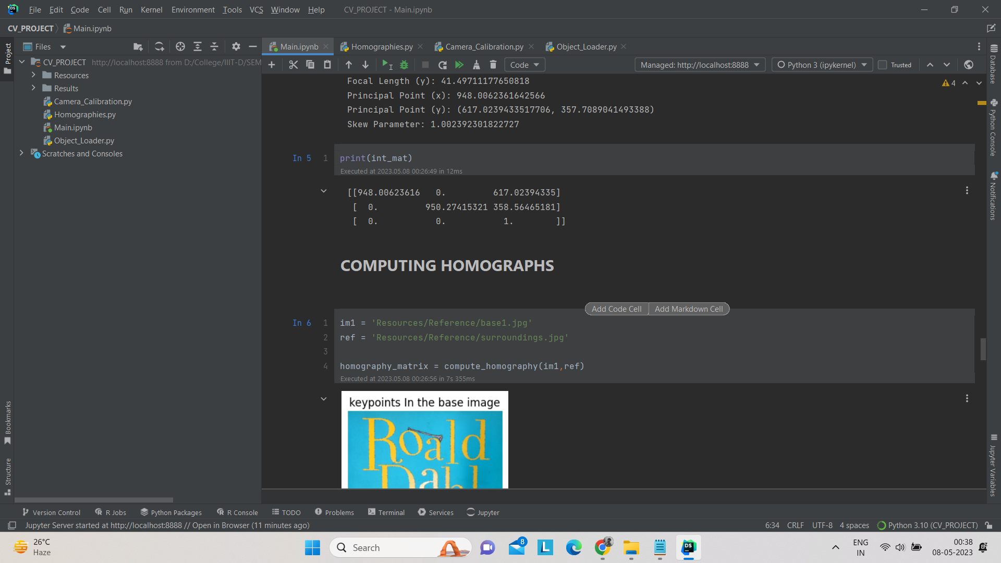
CAMERA CALIBRATION
Calibrating the camera to get the intrinsic camera parameters which will be required later while projecting our 3d model.
…

Slide 7

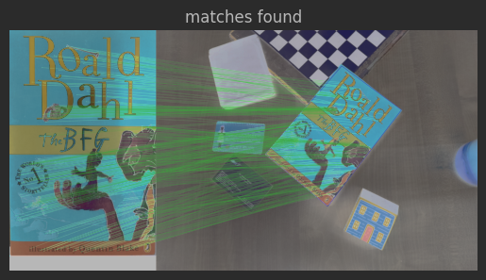
2. COMPUTE HOMOGRAPHIES
Computing the homographise of each frame of live video with our reference base image. We first detect key points using SIFT and then we Use Flann based algorithm to find our matches and then finding our homography matrix.
No. of good matches found 681

Slide 8
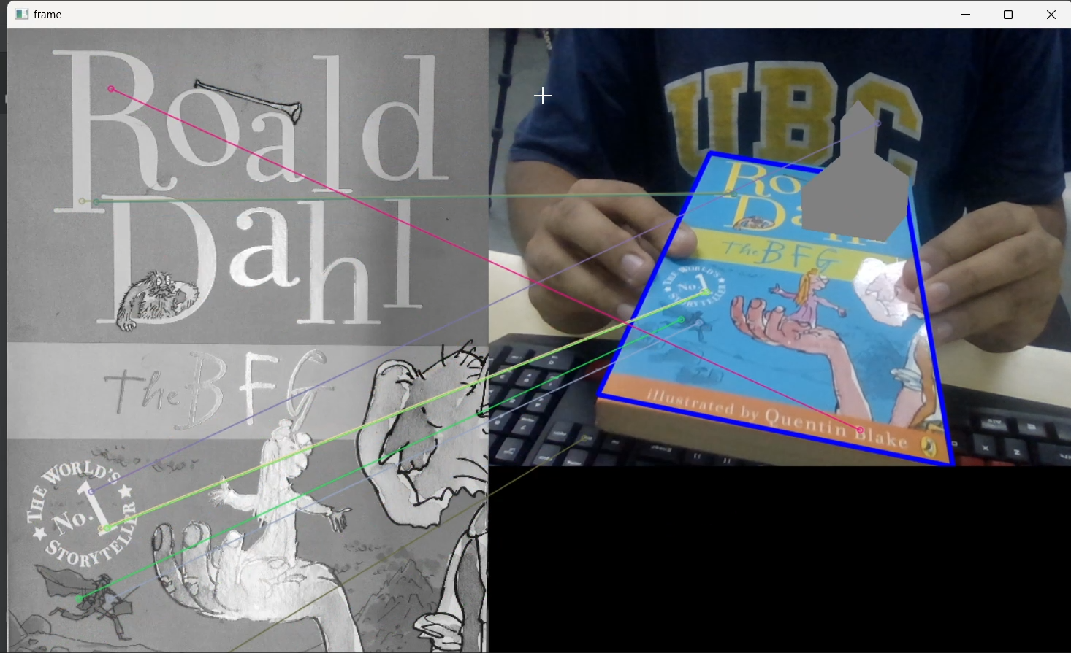
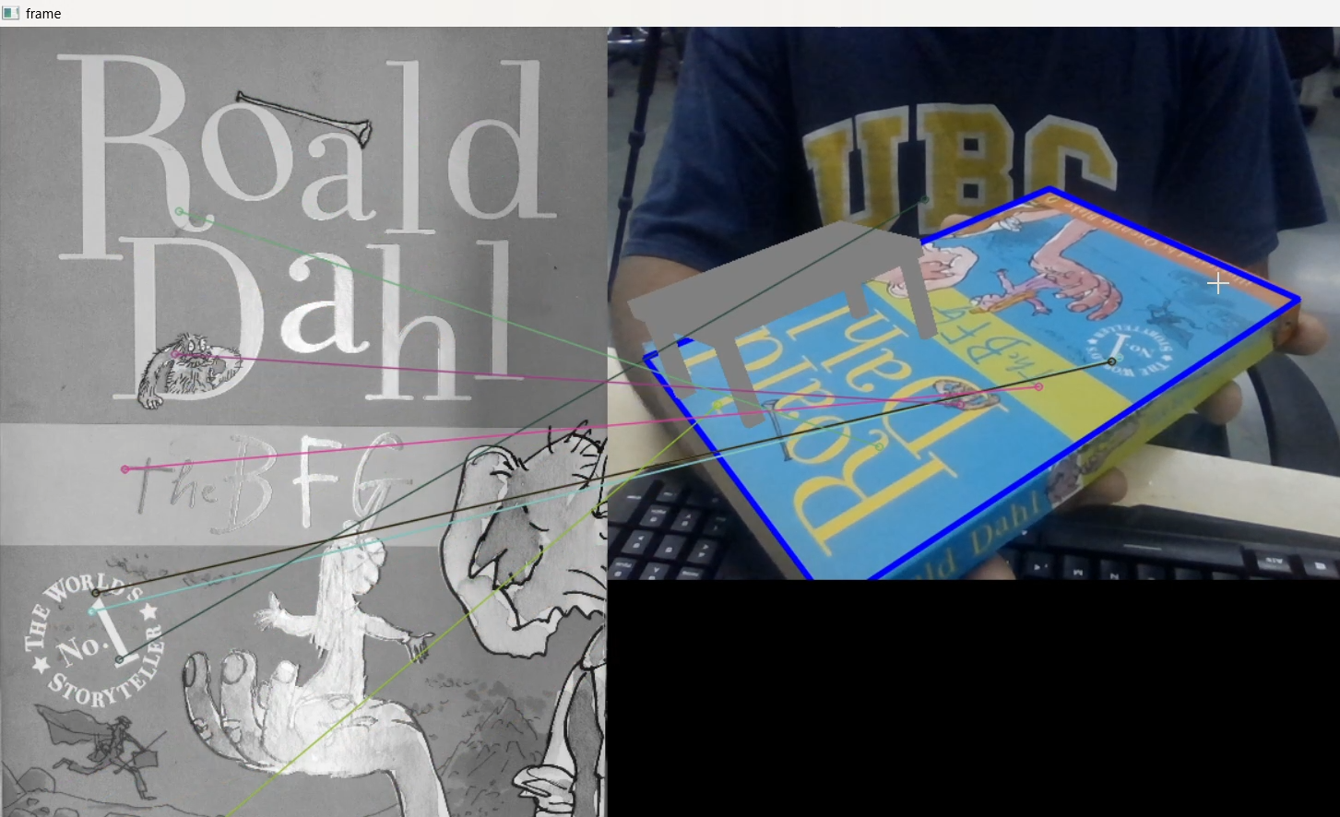
RESULTS
These are some of the results of the A.R. object Insertion. Video is within the RESULTS folder in our project file.

Slide 9
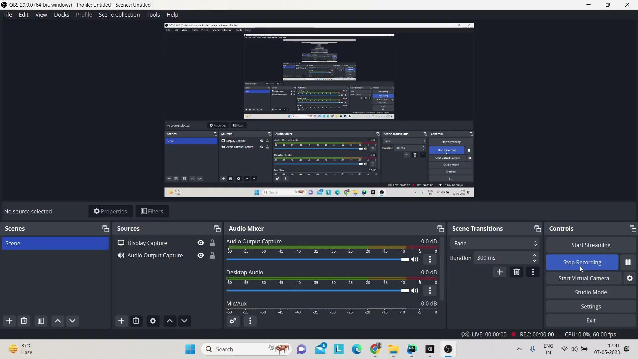
VIDEO AND WORKSPACE

Slide 10
RESULT AND ANALYSIS
On analysing our results we saw that the projection was good but not perfect. There were issues such as …
Heavy jittering of objects on some orientation of base, which clearly told us that homography matrix being computed was not accurate.
When the live camera does not detect the base it is detecting some points in the surrounding and considering them to be good matches, which gives us a drastically moving 3d object all across the camera which points out to the fact that we may need to make our SIFT/ORB model more robust, accurate and efficient.
On frames where the orientation is proper and the main features of the base are not occluded, we get a correctly oriented and stable 3d AR model on top of our base.

Slide 11
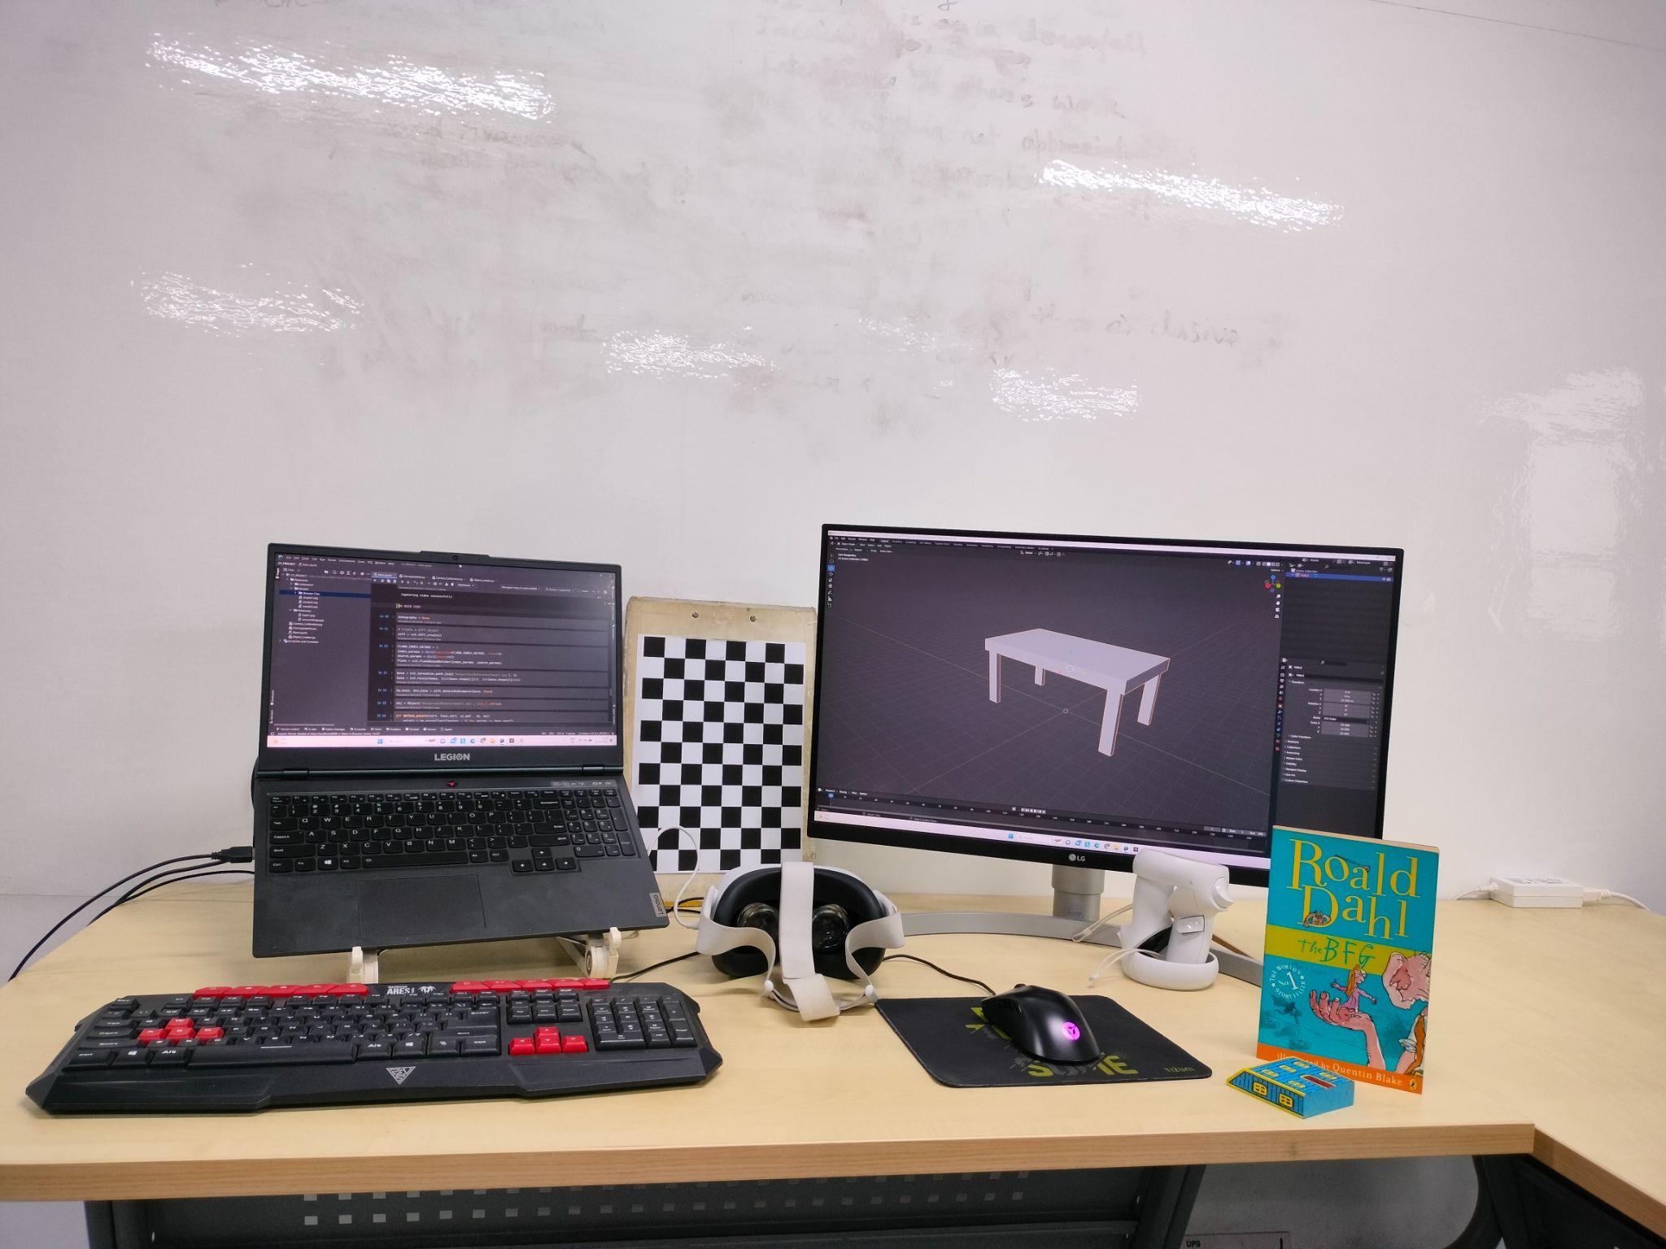
FUTURE WORK AND CONTRIBUTION
FUTURE WORK:
We can still make the A.R. experience much better if we keep these in mind …
The user should be able to interact with the 3D object, changing its position and orientation relative to the planar surface, as well as its size and appearance.
The application should be able to handle variations in lighting conditions and camera positions, and provide accurate and smooth rendering of the 3D object. (Also incorporate HD textures)
The resulting AR experience should be intuitive and user-friendly, with clear visual feedback and minimal latency.
GROUP CONTRIBUTIONS:
Harsh Vardhan Singh (2020202) :
Code(camera calibration/homography/rendering)
PPT
Project compilation
Pravar Agarwal (2020229) :
Code(homography/rendering)
Report
PPT
Subhanshu Bansal (2020135) :
Code(camera calibration/homography)
Report
Project compilation
OUR WORKSPACE

